Slide 1



Slide 2
Working with Triggers
When you decide to create a trigger, its mostly to maintain a log of activities i.e. what has occurred to your table or schema or database
Once created, Triggers are executed automatically at chosen times i.e., they are dependent for their execution on some event that happens
The trigger is executed like a daemon process i.e. in the background. Users will not be aware that a trigger has been executed
The trigger can be designed to store the activities when it is executed. For this we can create another table which will act as a log book for user activities. Such a table, will only have records, if the trigger executes so we need to take care that primary key of such a table is generated

Slide 3

What is a Trigger?
It is a PL/SQL program unit
It is associated with a particular table
It is stored in the data dictionary after successful compilation
It is executed automatically whenever a certain event occurs in the associated table.
Can be fired(i.e. executed) before or after a triggering event.
Gets dropped when its associated table is dropped

Slide 4
Creating a Trigger : Syntax
CREATE [OR REPLACE] TRIGGER TriggerName
BEFORE |AFTER triggering_event[s] ON TableName
[FOR EACH ROW]
DECLARE
--Declaration statements
BEGIN
--Executable statements
[EXCEPTION
--Exception-handling statements]
END;
Trigger Specification
Trigger Body
[anything within square brackets] – Optional

Slide 5
Rules for Trigger Specification
For a trigger specification, you need to first use
CREATE [OR REPLACE] statement followed by a trigger name.
After the trigger name, you need to specify the timing at which the trigger will be executed or fired (i.e., BEFORE or AFTER).
Then, you need to specify the triggering event(s) that will cause the trigger to fire. You can list a single event or a list of events separated by the OR keyword.

Slide 6
Triggering Events
There are three categories:
  DML events : These events involve changes to the data in the rows of a table and include INSERT, UPDATE, or DELETE.
  DDL events : These events are associated with changes to the definition of objects in the database such as tables, views, procedures, etc. These events include CREATE, ALTER, or DROP statements. The name of table is replaced with SCHEMA
  Database events : These events include server errors, users logging on or off, and the database being started or stopped. The name of table is replaced with DATABASE

Slide 7
Rules for Trigger Specification
Following the table name, a trigger level is specified.
  A trigger can be either a Row-level Trigger or a Statement-level Trigger.
  When the optional FOR EACH ROW clause appears, the trigger is a Row-level Trigger. In this case, the trigger would be fired for each row that is changed. This clause applies to DML triggers,
  For DDL and database triggers, the FOR EACH ROW clause should not appear, indicating that these are statement-level triggers.

Slide 8
Other statements
To remove a trigger from the schema
  DROP TRIGGER trigger_name;
To check for compilation errors, if encountered
  SHOW ERRORS TRIGGER trigger_name;

Slide 9
Some Examples Of Trigger Specifications
Example 1: DML Trigger
Fired before an update is performed on the first or last name of an employee
CREATE TRIGGER NameChange
BEFORE UPDATE OF first_name, last_name ON Employees
FOR EACH ROW
Example 2: DML Trigger
CREATE TRIGGER AlterEmployee
AFTER INSERT OR UPDATE OR DELETE ON Employees
FOR EACH ROW
Fired when any DML statement (INSERT, UPDATE OR DELETE) is performed on the Employees table
Example 3: Database Trigger
CREATE TRIGGER ErrorLog
AFTER SERVERERROR ON DATABASE
Fired whenever there is an error with the database server
Example 4: DDL Trigger
CREATE TRIGGER TrackChanges
AFTER CREATE ON SCHEMA
Fired when a new database object is created

Slide 10
Sequence
A sequence can be used to automatically generate a serial list of unique numbers for a numeric column in a table.
Creating a sequence as shown below:
  Syntax:
CREATE SEQUENCE <sequence_name>
START WITH <start_number>;
  Example:
CREATE SEQUENCE seq
START WITH 1;
To generate the numbers,
  sequence_name.nextval;

Slide 11
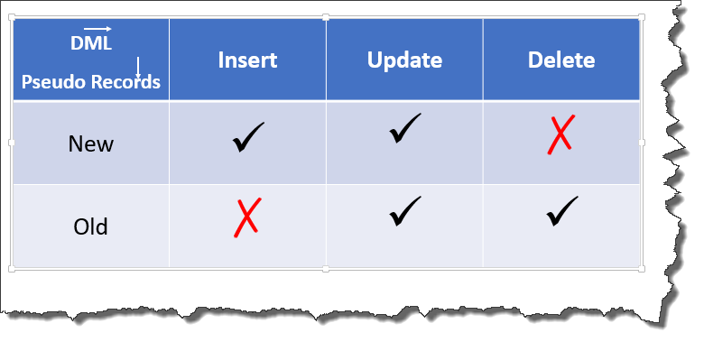
Using :NEW or :OLD
The :OLD pseudorecord allows you to access the current / “old” information of the record being updated.
The :NEW pseudorecord allows you to access the “new” information for the current record.

Slide 12
To create a log table: USR_LOG
Name Null? Type
LOG_ID NOT NULL NUMBER
LOG_DML VARCHAR2(30)
LOG_KEY_ID NUMBER(38)
LOG_DATE DATE
LOG_USR VARCHAR2(20)

Slide 13
Example: Trigger
CREATE OR REPLACE TRIGGER USR_LOG
BEFORE INSERT OR DELETE OR UPDATE ON Locations
FOR EACH ROW
BEGIN
IF INSERTING THEN
INSERT INTO trig1_log(log_id, log_dml, log_key_id, log_usr, log_date)
VALUES(seq.nextval, ‘INSERT’, :new.loc_id, user, SYSDATE);
ELSIF DELETING THEN
INSERT INTO trig1_log(log_id, log_dml, log_key_id, log_usr, log_date)
VALUES(seq.nextval, ‘DELETE’, :old.loc_id, user, SYSDATE)
ELSE
INSERT INTO trig1_log(log_id, log_dml, log_key_id, log_usr, log_date)
VALUES(seq.nextval, ‘UPDATE’, :old.loc_id, user, SYSDATE);
END IF;
END;

Slide 14
Worksheet of Trigger
Create following table:
Table Name: Contacts
Create a Trigger which will maintain a log after a record is added on the above table.
Create a Trigger which will maintain a log after a record is deleted or updated on the above table.
Columns | Data type | Contraints
ContactID | Number(3) | Primary Key
First Name | Varchar2(50) | Not Null, Unique
Last Name | Varchar2(50)
Phone | Varchar2(12) | Not Null

Slide 15
To create a log table: USR_LOG
Name Null? Type
LOG_ID NOT NULL NUMBER
LOG_DML VARCHAR2(30)
LOG_KEY_ID NUMBER(38)
LOG_DATE DATE
LOG_USR VARCHAR2(20)

